Slide 1
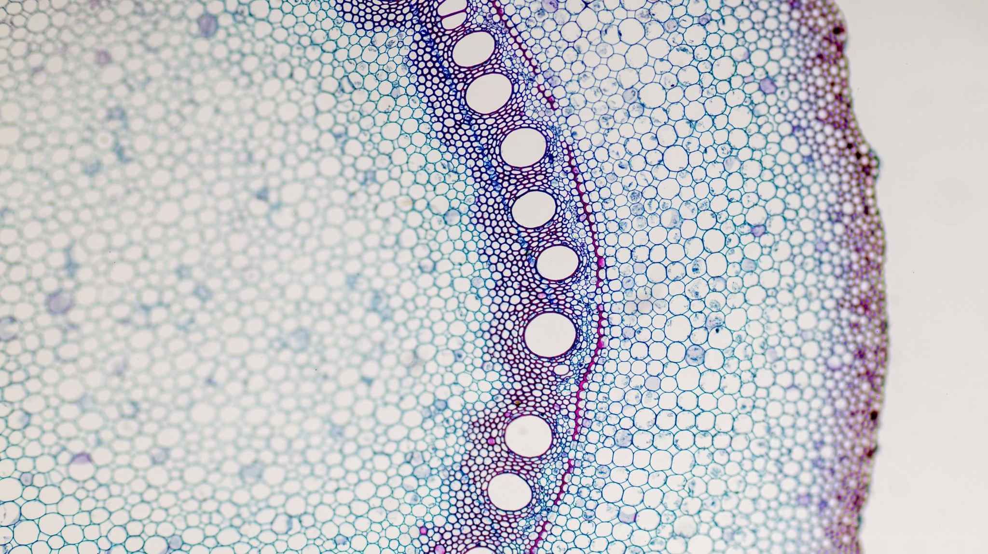
Semi-supervised cell segmentation
Dr. Sebastian Schürmann, Dobrovolskii Sergei

Slide 2
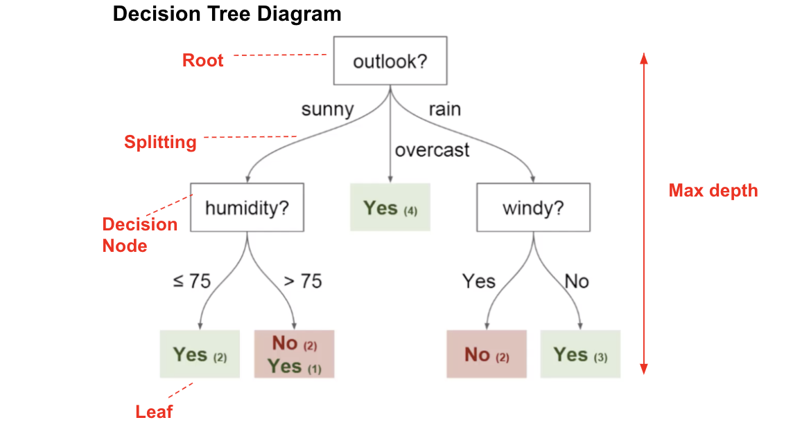
Classification and Regression tree (CART)
The idea of CARTs is to
Recursively subdivide the sample space
To perform classification or regression locally in each partition
This subdivision is naturally represented as a binary tree
Each internal node encodes a split of the feature domain
Left and right successor nodes operate on the “left” and “right” part of the split
If the split is sufficiently simple (e.g., a threshold along one of the dimensions), define “left” as below the threshold, and “right” as above
The leaf nodes perform the actual task on the samples
For classification, return the relative frequencies per class

Slide 3
CART Training
Each node has 2 parameters: one axis-aligned split along one dimension
The tree has a maximum height, which is a hyper-parameter
Training steps:
The tree is grown greedily from root to leaves
At each node, perform an exhaustive search for the best split w.r.t. an objective function Qm(T) (→ best dimension, best position)
Stop splitting a node if only few samples are left in this branch
Prune the tree by merging those splits with least cost increase. Pruning cost function is tradeoff between model accuracy and model complexity

Slide 4
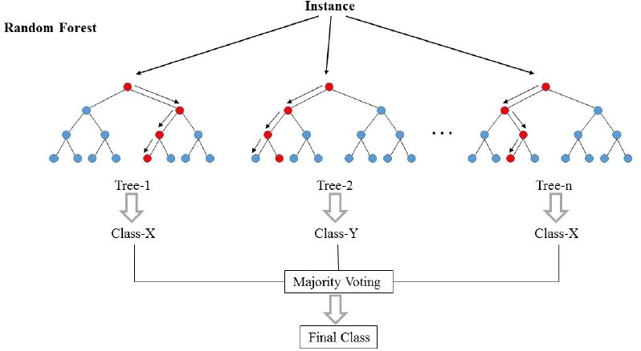
Random forest

Slide 5
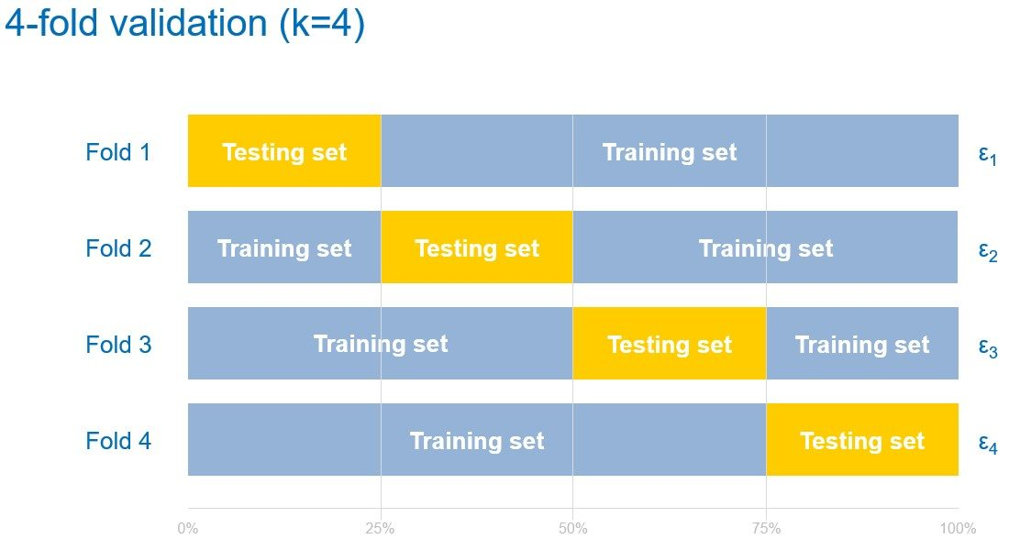
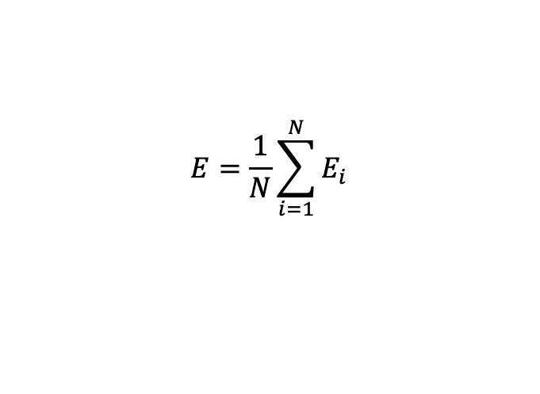
Cross-Validation
ML strategy for the estimator performance evaluation.
Dataset is splitted into training dataset and testing dataset. At each fold the testing set is diffent. Errors from each fold are averaged to get the final model performance:
$$E=\frac{1}{N}\sum_{i=1}^{N}{E_{i}}$$

Slide 6
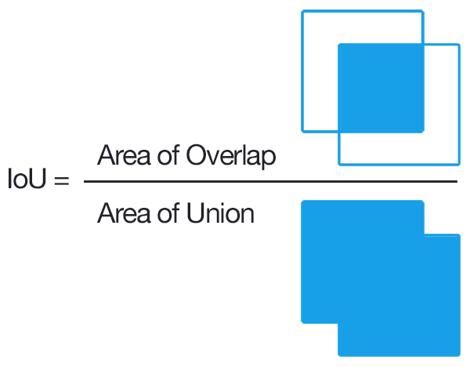
Accuracy metric
Accuracy metric :
Intersection over Union IoU. Spans from 0 to 100% accuracy
Potential evaluating steps:
Training accuracy
Validation accuracy
Test accuracy

Slide 7
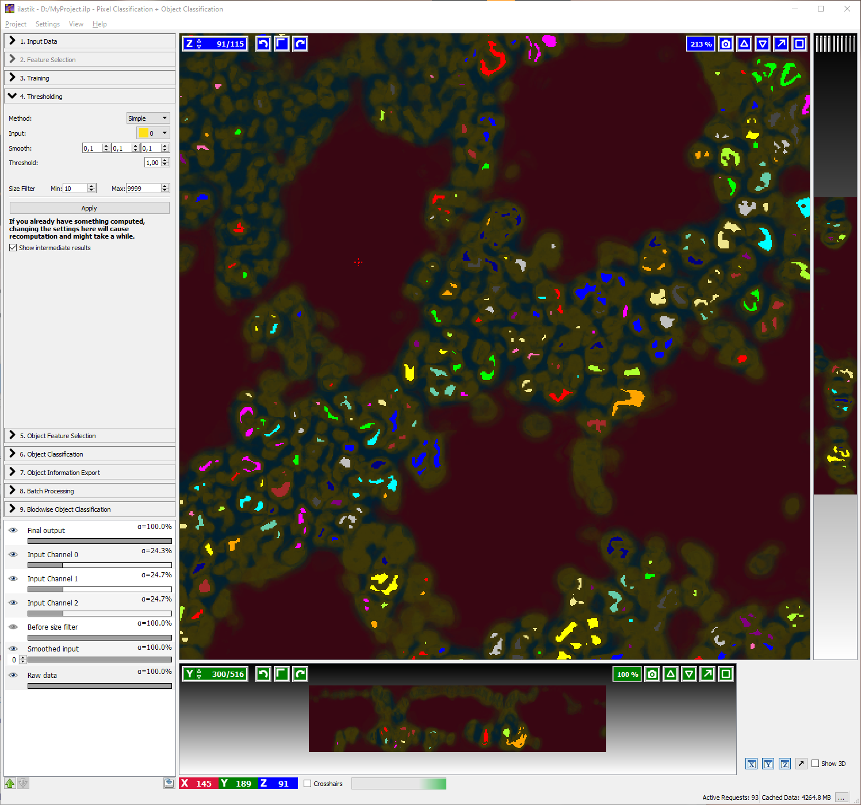
Ilastik

Slide 8
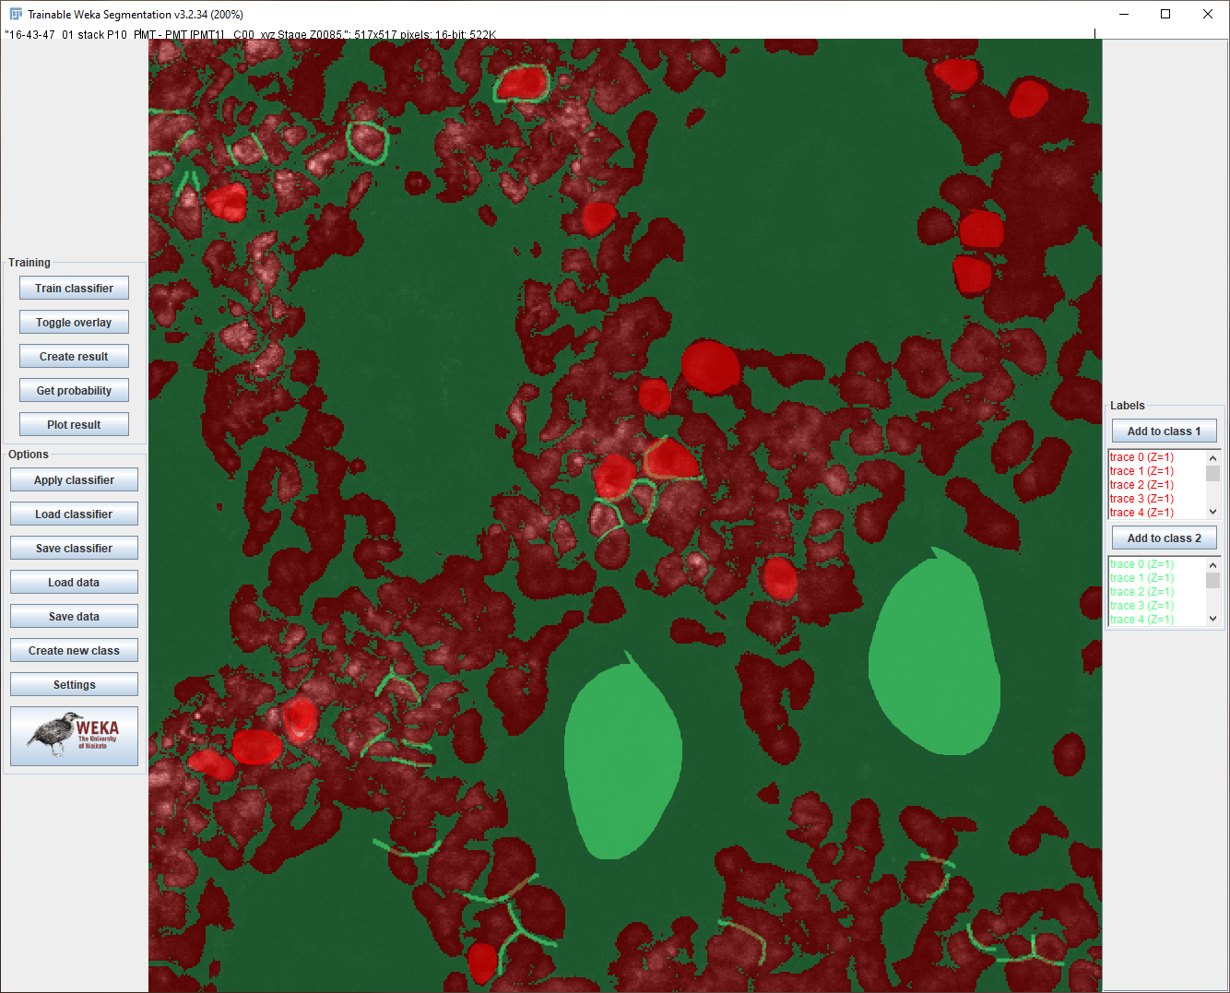
FIJI Weka plugin

Slide 9
Current Framework:
Stack – class for convenient 3d data handling
Classifier – class for Random forest training
Augmenter – class for feture maps creation (requires refactoring)

